Slide 1
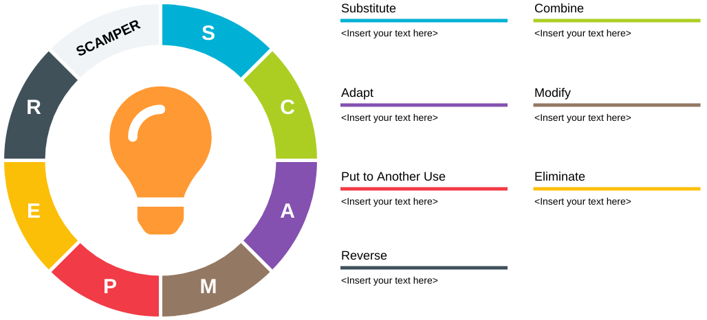
S stands for Substitute
C stands for Combine
A = Adapt
M = Magnify
P = Put to Other Uses
E = Eliminate (or Minimize)
R = Rearrange (or Reverse)

